Slide 1
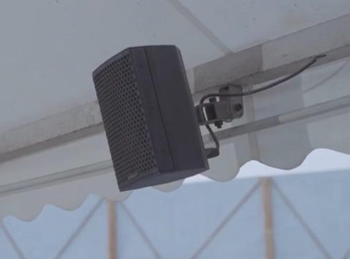


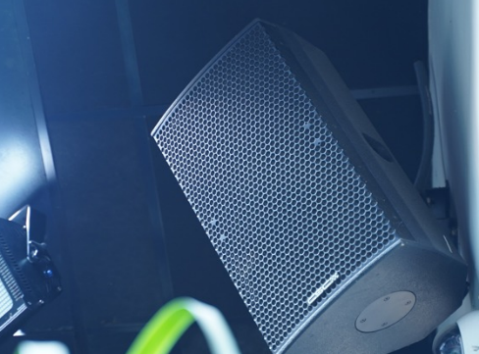

Slide 2
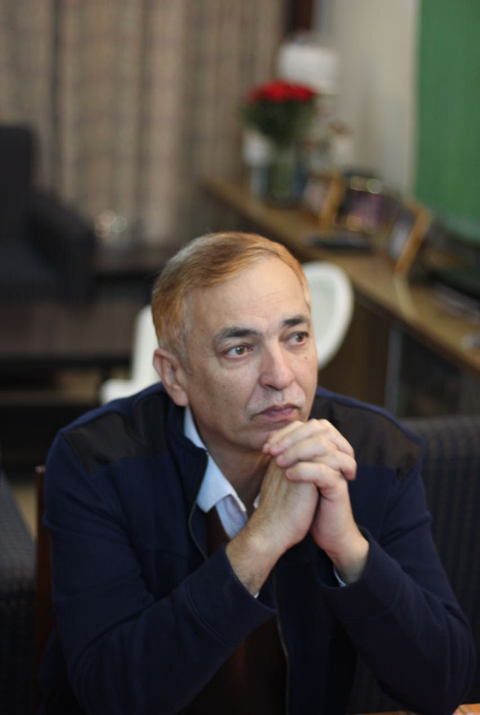
ABOUT CSC AUDIO
Celebrating 21 years of Excellence.
Founded in 2003 in the UK, CSC Audio epitomises British design fused with German engineering and Indian craftsmanship with the mission to produce high-quality and robust products for international markets.
With Performance at our core, CSC has evolved over the years and developed a comprehensive range of products and systems tailored for Pro-installation, Commercial installation and Touring, including amplification and signal processing.

Slide 3


Vision
& mission
By providing top-quality professional audio products that are best-in-class, we hope to propel the advancement of the audio industry by setting new industry benchmarks for innovation. Our goal is to become a trusted name in the professional audio products industry.
Our mission is to design and deliver industry-leading audio products using world-class components and technology, offering an exceptional audio experience. Our dedicated and highly skilled team strives to meet and exceed customer expectations, ensuring every product coming out of our facility is unbeatable per dollar spent. Our philosophy is simple: we create products of uncompromising quality.

Slide 4





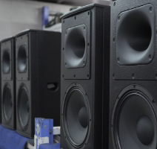
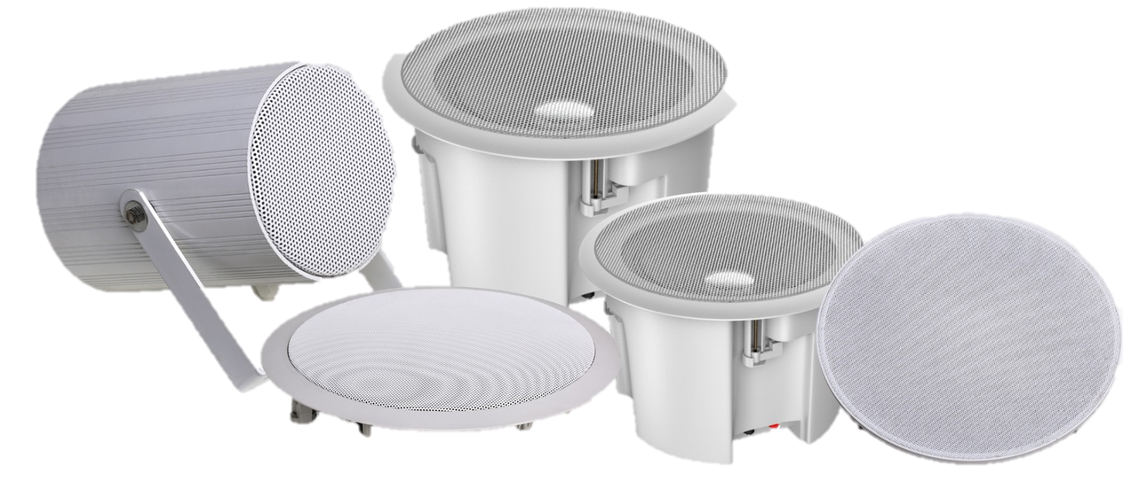


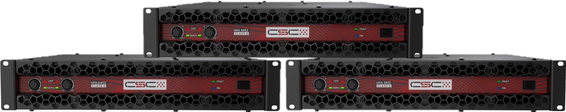
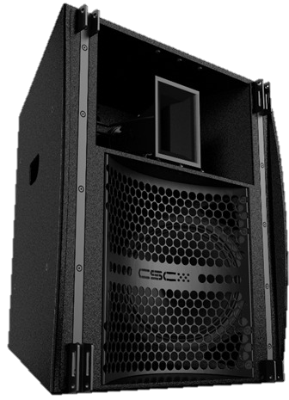


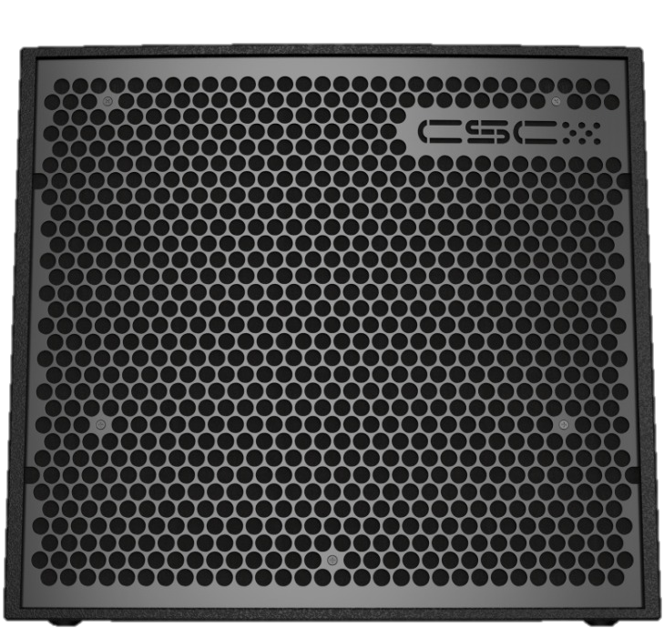

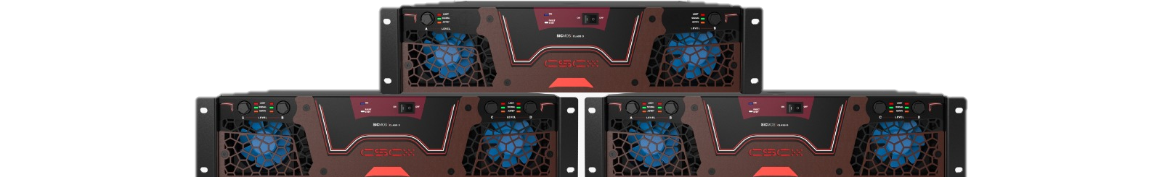
Csc audio – 21 years of excellence
2003
2006
2008
2013
2014
EXPANDED REACH ACROSS 5 COUNTRIES
STARTED SELLING IN INDIAN MARKET
FORMED BRITISH-INDO-GERMAN CONGLOMORATE
SETS UP R&D CENTRE IN GERMANY
ESTABLISHED IN UK
2018
2017
2016
2015
2014
LAUNCHES HPA SERIES OF CLASS D AMPLIFIERS.
SETS UP 20,000 SQ FOOT ASSEMBLY UNIT IN INDIA
EXPANDS COMMERCIAL SERIES WITH HARP PRODUCT RANGE
LAUNCHES ROAD-READY SERIES OF TOURING RANGE
LAUNCHES CELLO & CONTRABASS SERIES OF PRO INSTALL
2018
2019
2021
2022
2024
1ST TIME IN AMPLIFIER HISTORY, CSC LAUNCHES MOD RANGE OF AMPLIFIERS USING SILICON CARBIDE DEVICES.
PATENTS ITS INNOVATIVE SHALLOWEST 15” SUB WOOFER – CB215S
LAUNCHES THE FLAGSHIP RR212HL, CSC’s 1ST HORN LOADED SYSTEM
EXPANDS FOOTPRINT ACROSS 15 COUNTRIES WITH OVER 50 PROFESSIONAL PRODUCTS
LAUNCHES NEW PRODUCTS IN CELLO AND STRING SERIES

Slide 5

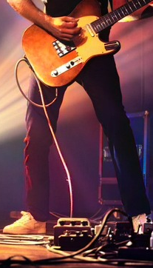
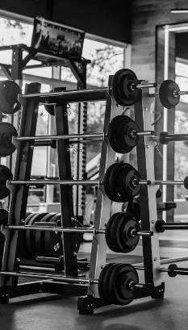
CSC Audio’s Pro-Audio range combines cutting-edge component technology with musical artistry to deliver exceptional performance. Each series is designed to provide superior audio experiences across diverse spaces and applications.
PLAY. HEAR. FEEL.

Slide 6

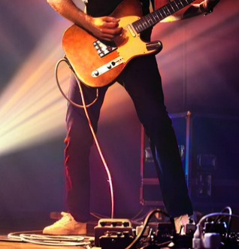
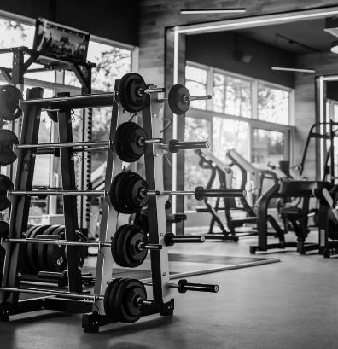
applications
PRO INSTALL
TOURING
COMMERCIAL INSTALL
Pro-Install solutions provide tailored audio systems for diverse venues, from clubs to expansive stadiums, ensuring unmatched sound clarity & coverage.
Touring Solutions are engineered for the rigors of the road, delivering robust and clear sound for live shows and performance venues & rental business.
Designed to enhance customer experiences, our Commercial Install products offer seamless sound integration for gyms, cafes, retail outlets etc.

Slide 7
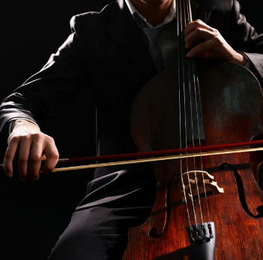
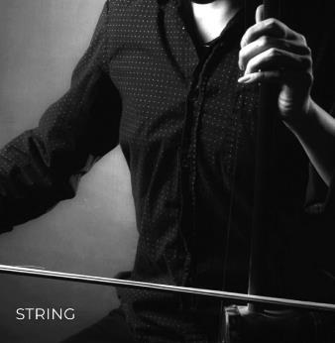
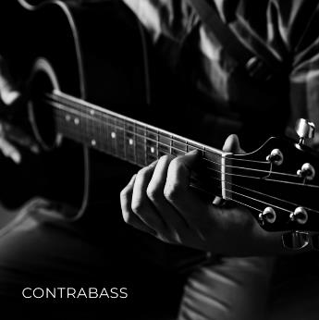
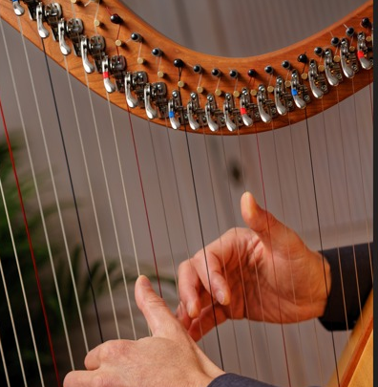
csc audio
PRODUCT series
CELLO
HARP

Slide 8
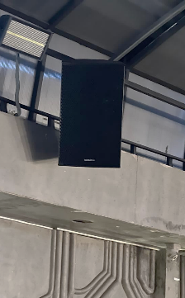
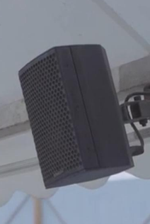
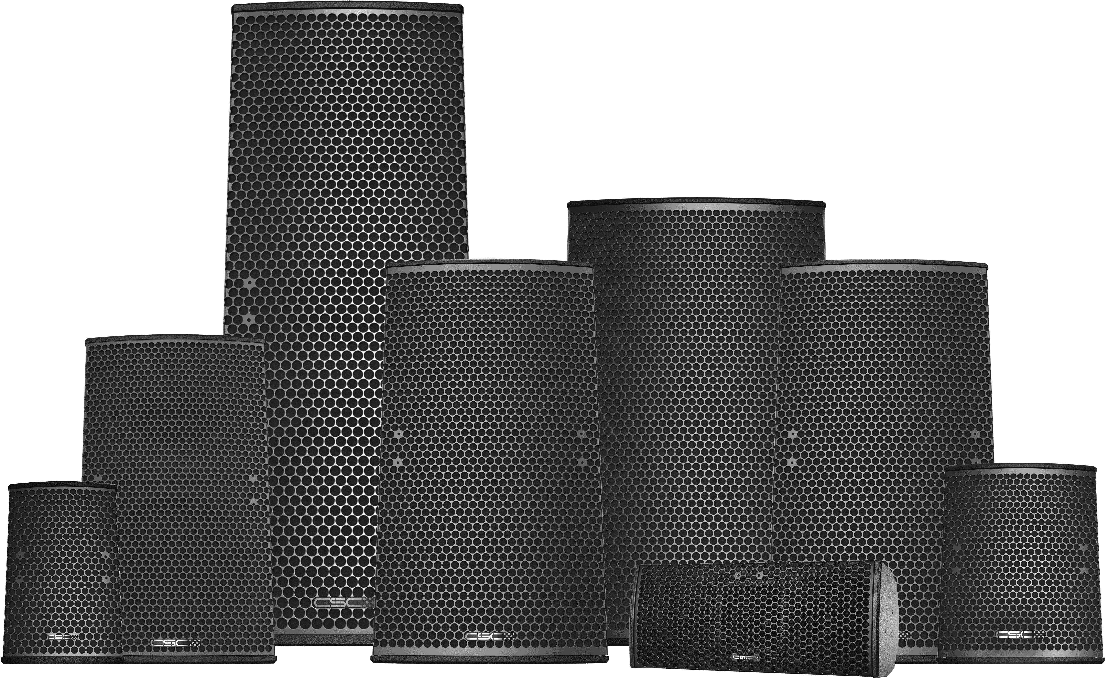
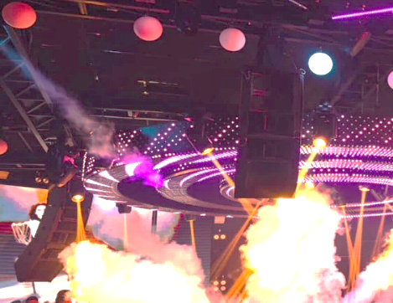
cello series
CF COLLAGE
Cello Series delivers acoustically transparent, tonally rich, and spatially neutral sound akin to the warmth & resonance of the instrument itself. Engineered for powerful performance, these loudspeakers provide depth & clarity, creating an immersive audio experience. Paired with Contrabass Series subwoofers, these excel in both pro-install and touring applications, delivering a cohesive, impactful soundstage.

Slide 9
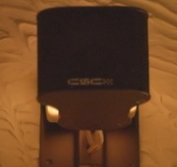
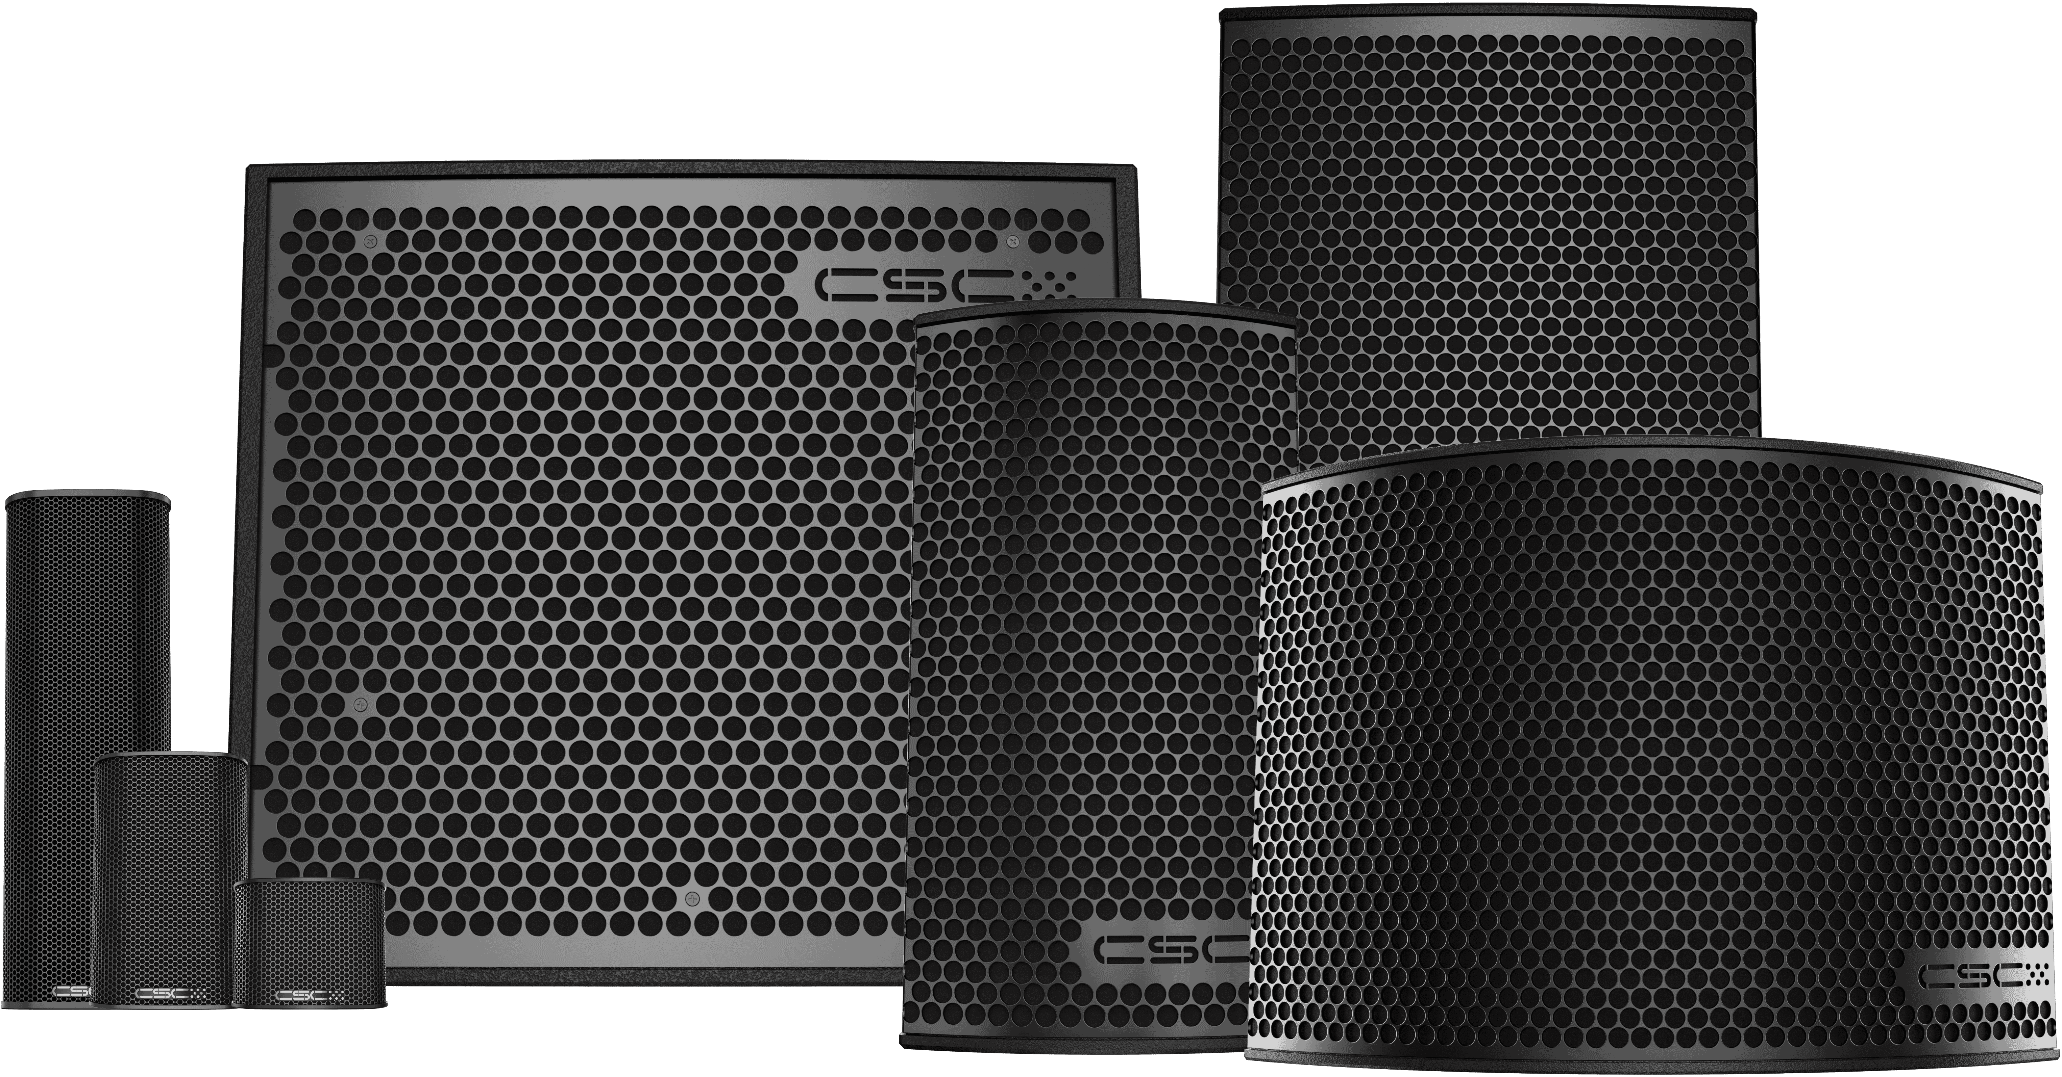
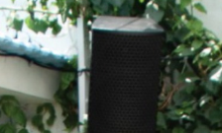
String series
The String Series offers a range of compact satellite speakers delivering harmonious, balanced sound reminiscent of the intricate qualities of string instruments. Engineered with thick-walled aluminum for near-zero resonance, they reproduce music with exceptional clarity. Ideal for pro-install and commercial use, they pair perfectly with Contrabass Series subwoofers for enhanced low-end impact

Slide 10
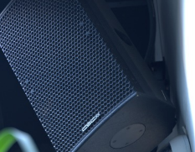
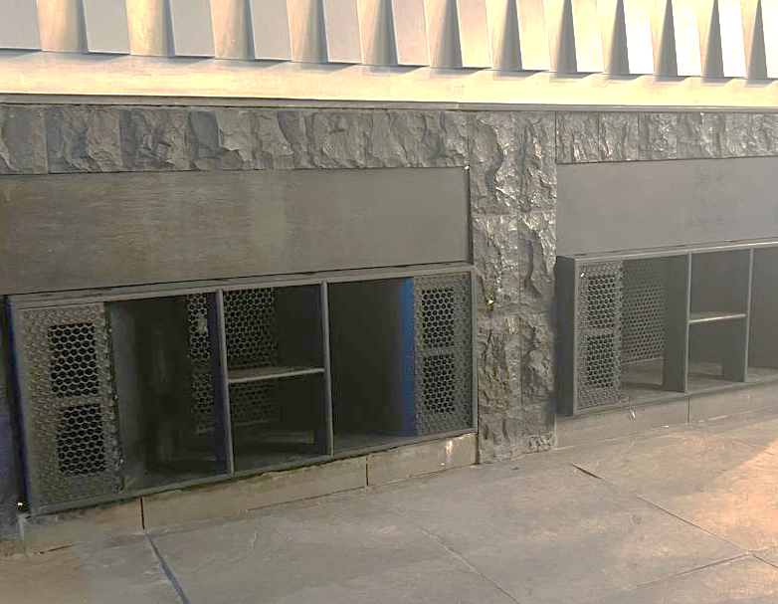
Contrabass series
The Contrabass Series delivers deep, impactful bass capturing the bold and dynamic characteristics of the contrabass with options like Reflex, Multi-load, and Band Pass designs. Engineered for minimal resonance, these subwoofers offer powerful low-frequency extension for both live sound and installation, fitting seamlessly in any venue.

Slide 11
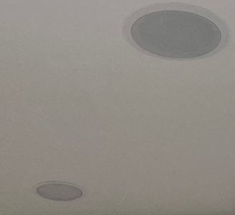
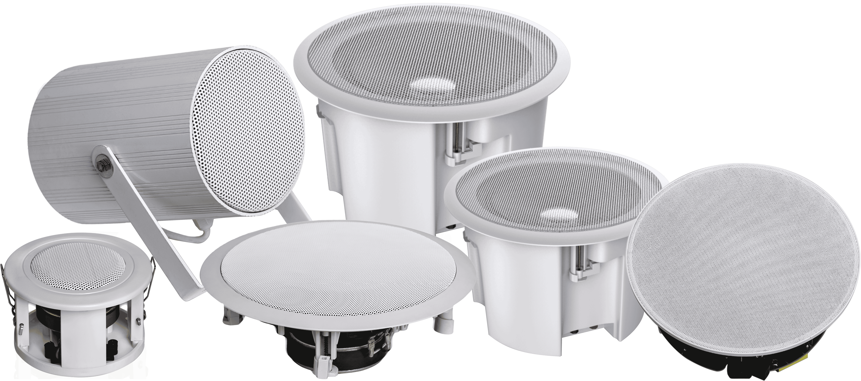
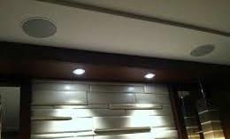
harp series
The Harp Series ceiling speakers deliver delicate, clear audio with a second-order crossover for enhanced performance & captures the delicate, clear, and gentle notes of a harp. Designed for commercial, residential, and home cinema applications, they provide distortion-free, immersive sound with even coverage and exceptional clarity.

Slide 12
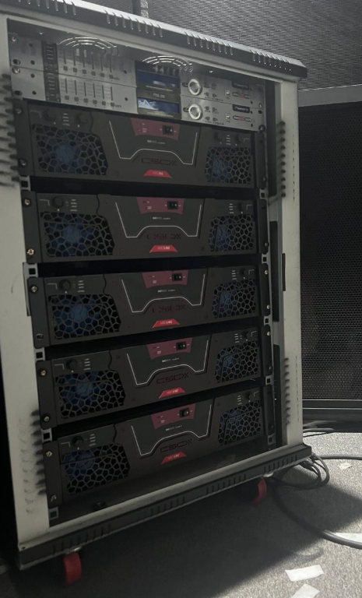
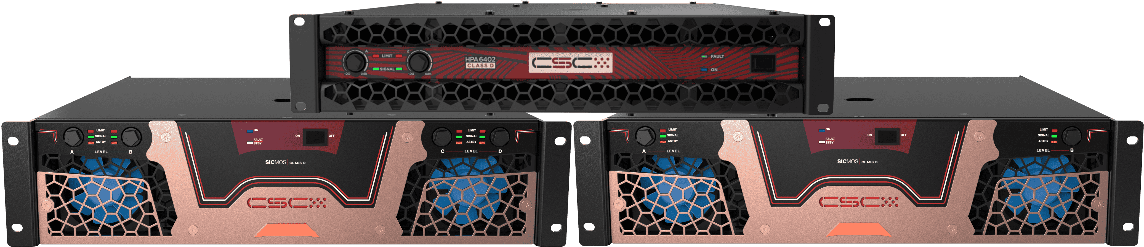
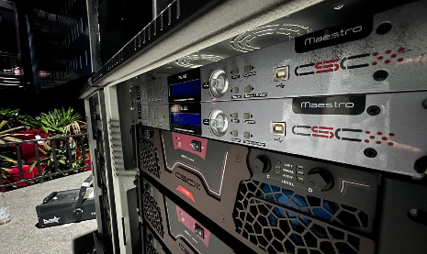
electronics
We offer high-performance amplifiers and advanced DSPs designed for professional audio environments. Our amplifiers provide robust power for large venues or crystal-clear sound in intimate settings. Our DSPs optimize audio clarity and precision, tailored to specific needs.

Slide 13

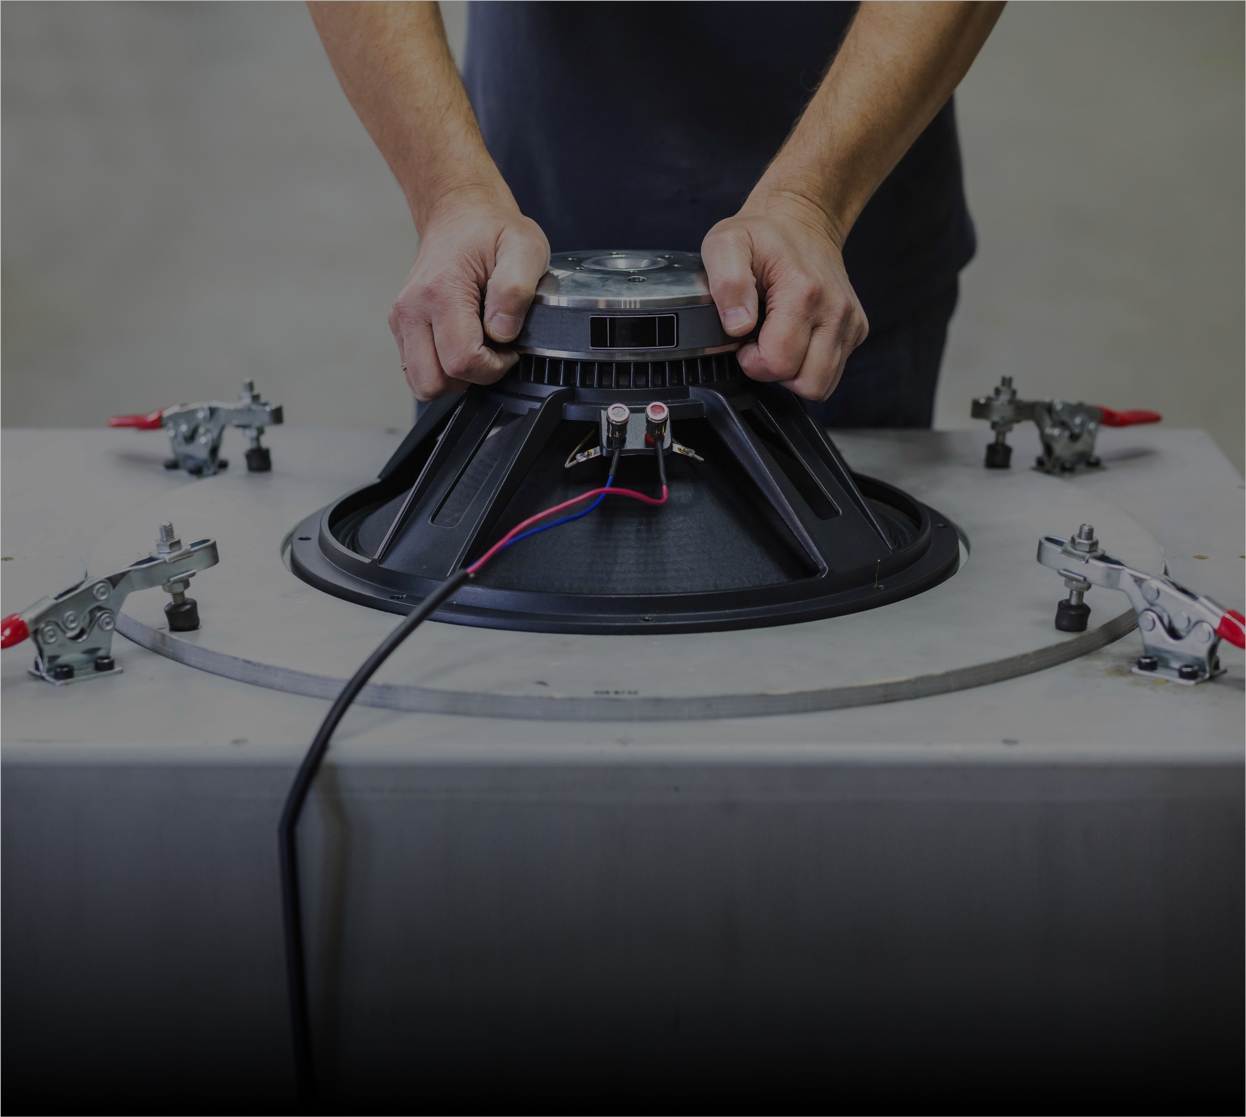
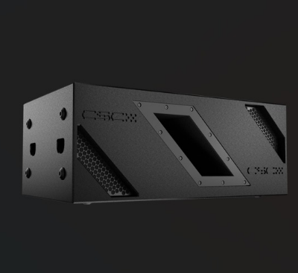
Engineered for excellence
All CSC products are designed and developed in its R&D facility in Germany.
Our team of passionate engineers ideate, prototype, test, and develop perfectly engineered products and solutions.
With our innovative design expertise, we’ve patented one of the shallowest double 15” subwoofers

Slide 14
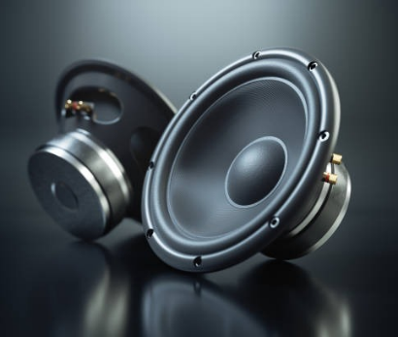
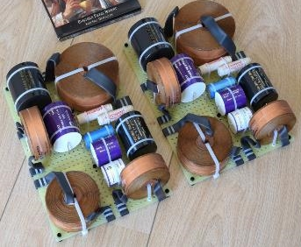
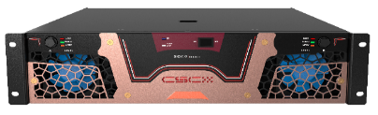
FROM COMPONENTS TO PEFRECTION
Drivers are imported from the best sources in Italy, France, and Spain.
We over-engineer passive crossovers to reduce distortion and thermal compression using low-inductance components..
Our amplifiers use a super-efficient silicon carbide device in Class D design, reducing heat loss and power consumption.

Slide 15
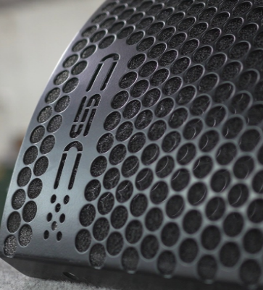
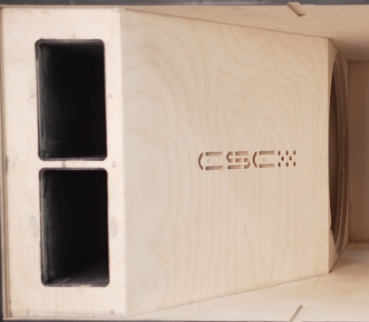
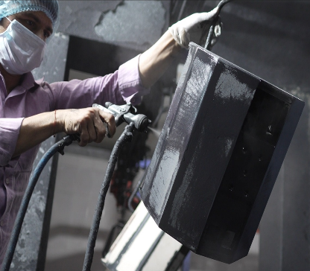
PRECESION IN EVERY PART
Loudspeaker cabinets are crafted from birch plywood or thick-walled aluminium extrusion for durability.
Loudspeaker Cabinets are painted inside and out with water-resistant, eco-friendly, UV-stabilized, and mold-resistant German paint.
Special alloys ensure speaker grills are corrosion-resistant, and all metal parts are treated for environmental protection

Slide 16
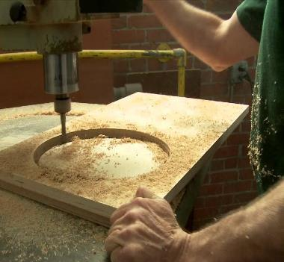
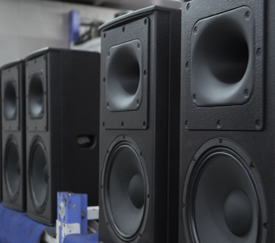
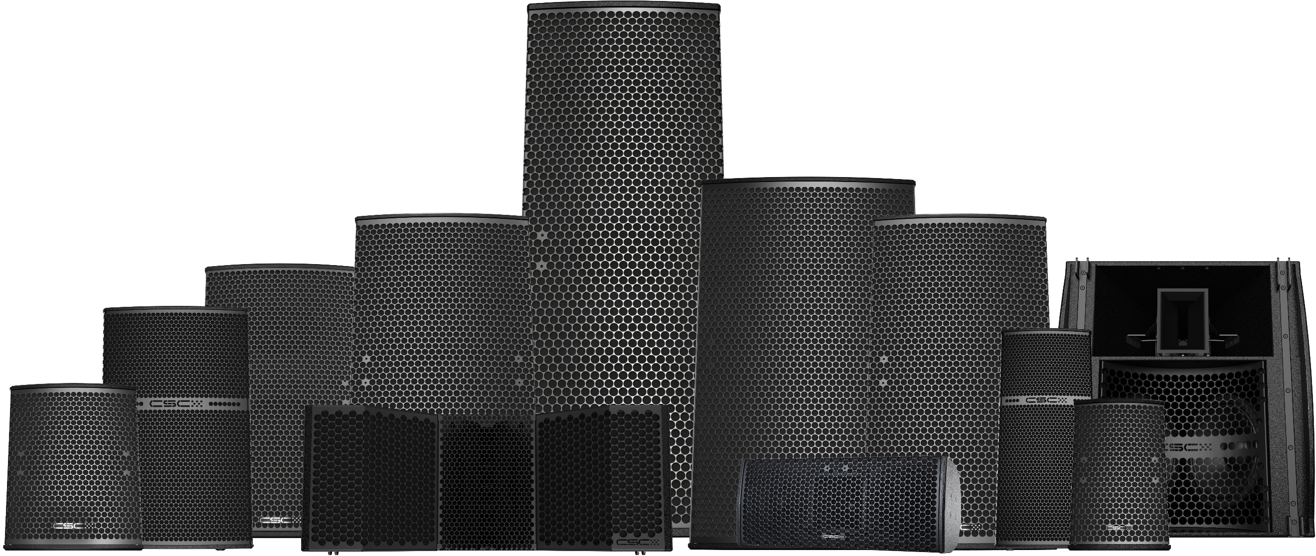
BUILT to perform & last
AT OUR 20,000 SQ. FEET STATE-OF-THE-ART ASSEMBLY FACILITY IN INDIA & WITH OVER 50 PROFESSIONAL TECHNICIANS
We manufacture 50+ high-quality pro audio products with precision and attention to detail.
We produce in small batches to ensure attention to detail and zero margin for error.
Every product undergoes rigorous testing to meet the highest industry standards for flawless performance.

Slide 17
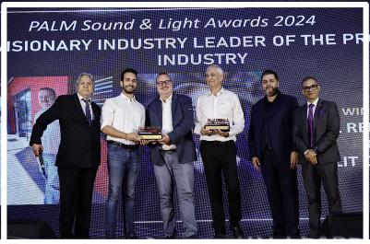



Compliant, eco friendly & award winning
Our products are certified with FCC, CE, and ROHS approvals and come with GLL files for venue simulations.
CSC uses 99% recyclable, biodegradable materials to keep the world plastic-free.
Directors Daniel & Lalit Chopra received the ‘Visionary Leader of the Pro AV Industry’ award at the Palm & Sound Awards 2024

Slide 18






















Our prestigious clientele
Trusted by renowned brands and chains across nightclubs, bars, and hotels, CSC has proudly completed over 2500 large installations worldwide and counting. CSC products have also been deployed at large government and defense establishments.

Slide 19

CSC products sell in 15 countries across Europe, the American continent, Asia, Africa, and the Middle East, and we are steadily expanding our footprint.
PLAY. HEAR. FEEL

Slide 20


Established in the UK engineered in Germany assembled in India
Played across the Globe
Celebrating 21 years of Excellence.
www.cscaudio.co.uk

